Slide 1
US Ignite – Fort Carson
Fall 2022 Mid-Term Presentation
Jonathan Wang, Yachen Guo, Ananya Raghupathy, Chengyuan Zhang, Satvik Kumar, Adithi Reddy Kallem
Notes:
Ananya
Jon: 7-13
Chengyuan: 14-16
Yc: 17-20

Slide 2
Agenda
Introduction
Project Background
Objective
Deliverables
Progress
Exploratory Data Analysis
Modeling
Further Steps
Notes:
Ananya

Slide 3






Team
Ananya Raghupathy MISM BIDA
Project Manager
Chengyuan (William) Zhang MISM General
Yachen Guo MISM BIDA
Adithi Reddy Kallem MISM BIDA
Jonathan Wang MISM General
Finance Lead
Satvik Kumar MISM General
Notes:
Ananya

Slide 4

Faculty Advisor
Neelam Dwivedi
Adjunct Professor, Heinz College
Notes:
Ananya

Slide 5

Client
Our client for this project is US Ignite.
a non-profit research organization
accelerating the smart cities movement
more than 160 federal, municipal, industry and academic partners.
Notes:
Ananya
For over ten years, US Ignite has worked closely with many federal agencies to help cities curate roadmap towards their smart city challenges, more specifically with Fort Carson, and the City of Colorado Springs.

Slide 6

Project Background
Goal is to optimize responses to inclement weather at Fort Carson
Notes:
Ananya
The Fort Carson Traffic and Weather Prediction Platform will analyze traffic and weather data in real time to optimize responses to inclement weather and traffic incidents at Fort Carson in Colorado Springs, Colorado. This project is an effort under the U.S. Army Engineer Research and Development Center (ERDC) contract with US Ignite and has been in the works since 2021.

Slide 7
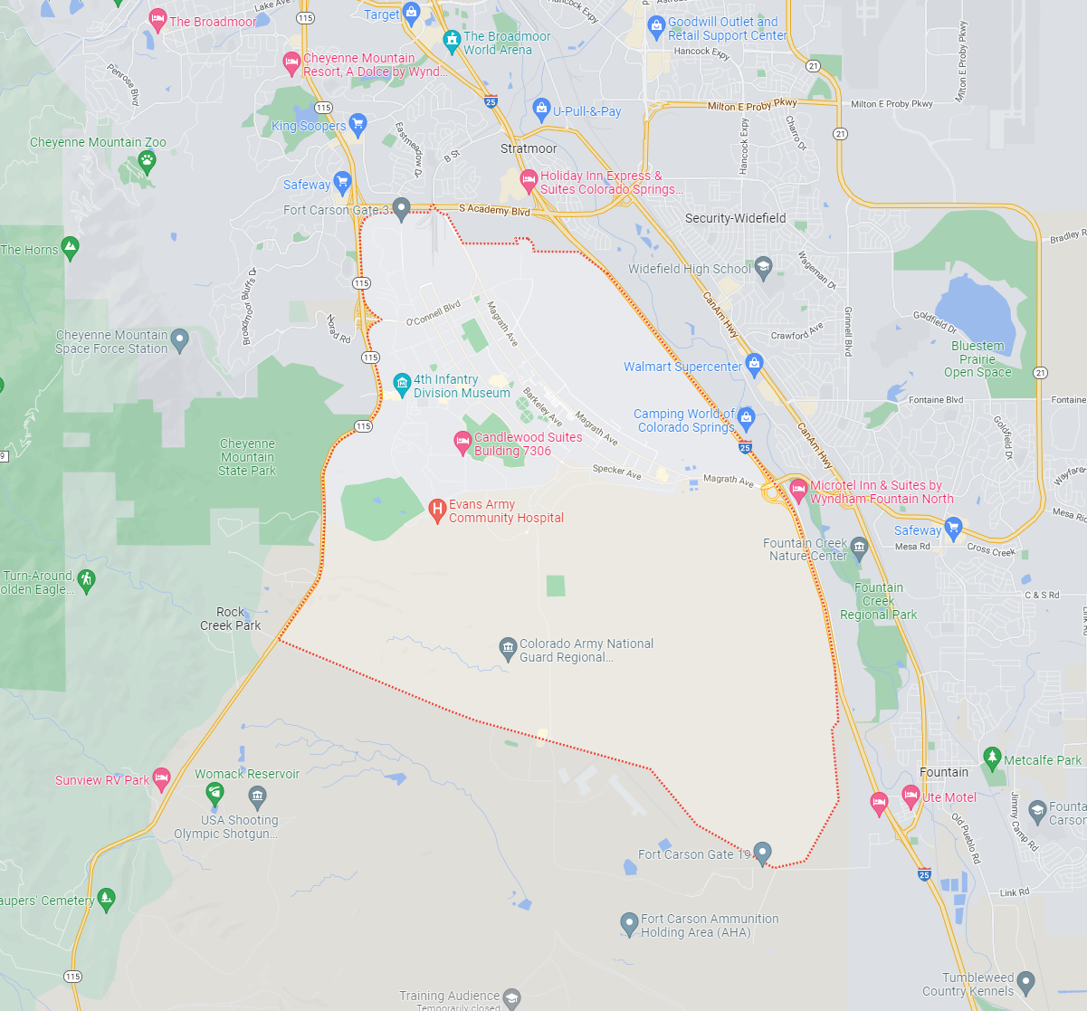
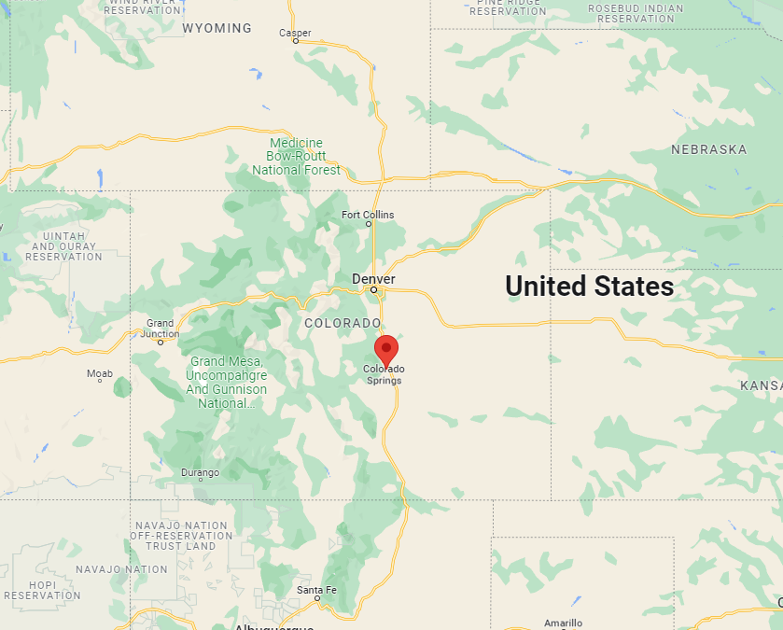
Where is Fort Carson?

Slide 8
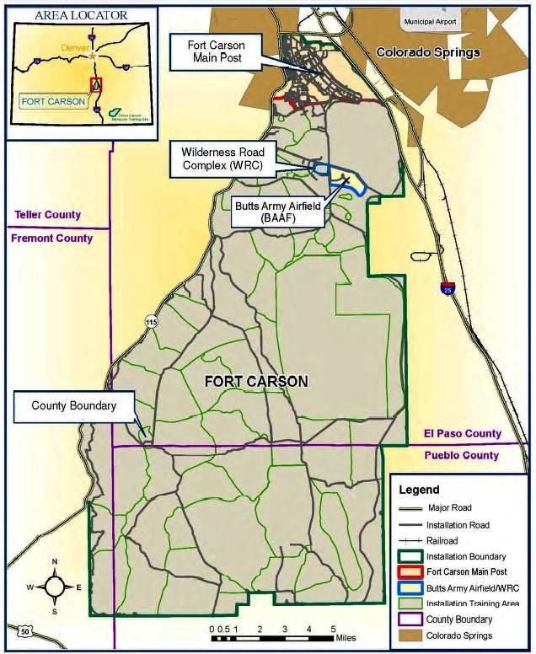
Fort Carson (contd.)
Fort Carson
City of Colorado Springs
2nd most-populous city in Colorado
Extreme weather conditions
Geographic Stats
Over 30,000 commuters daily
7 main entry gates
7 major roads nearby
Notes:
Colorado Springs is the largest city in El Paso County, and is the second-most populous city in the state, and the 40th-most populous city in the United States.
In 2016, El Paso county had the 4th highest traffic fatalities out of all Colorado counties.
Read slide
Considering the frequent inclement weather and large civilian population passing through nearby, there is plenty of traffic on the major roadways surrounding the base which directly impacts base personnel.
Up next, I want to give a brief overview of the key stakeholder.

Slide 9

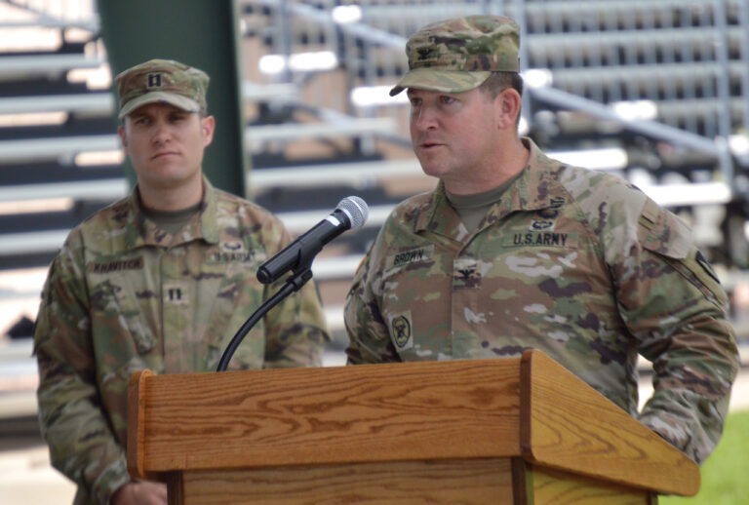
Key Stakeholder
GARRISON SAFETY OFFICER
“As the Garrison Safety Officer, I want to know the likelihood of weather-related driving accidents tomorrow, so that I may plan to close/open the base accordingly.”
Col. Sean M. Brown, commander, U.S. Army Garrison Fort Carson
Notes:
Our team’s job is to support US Ignite in their goal of helping military installations solve operational challenges. Specifically here, to help the Garrison Safety Officer in their decision making process.
Here is our main user story. Read slide

Slide 10
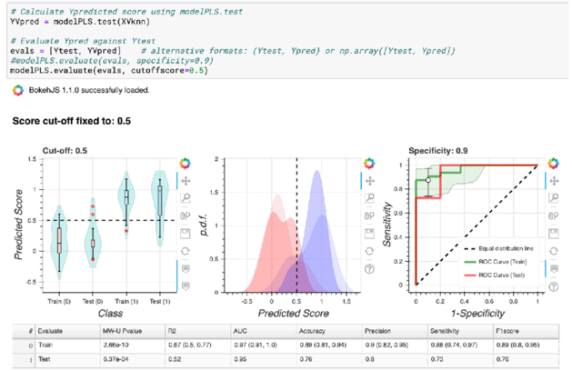
Prior Work
Fall 2021 Capstone Team
Data Exploration
Incidents data
Weather data
Developed User Stories
Identified Predictive Models for congestion

Slide 11

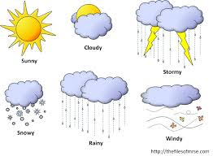
Our Objective
How can we implement an informed model to create a road-safety metric to help guide the decision of: closing the base early, delaying the opening of the base, or closing the base for the day?
Notes:
As mentioned before, inclement weather and frequent commuters are a safety hazard which can affect base productivity and quite literally; people’s lives.
So, the problem we are trying to solve:

Slide 12
Client Deliverables
Define a Safety Metric for each road:
Black (Extreme Risk)
Red (High Risk)
Amber (Medium Risk)
Green (Low Risk)
Classifier Model
Map/Dashboard

Slide 13

Agile Approach
Understanding the scope
Narrowing the problem
Potential Solutions
Review and Refine

Slide 14
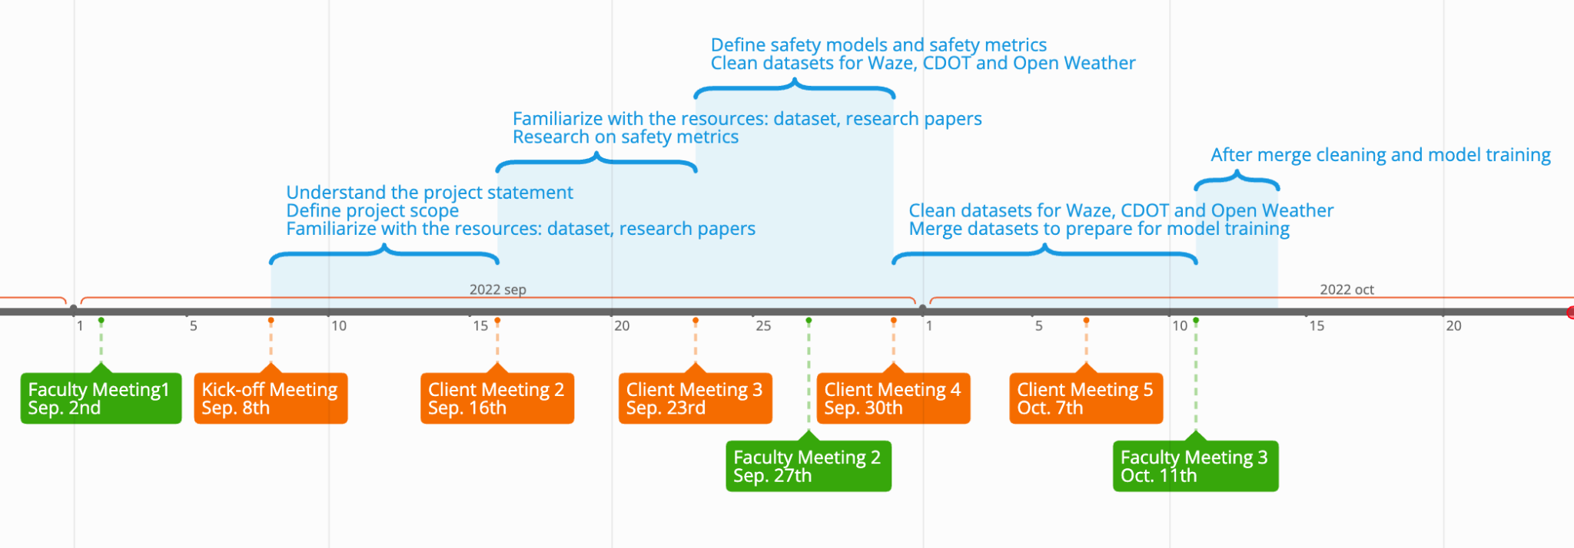
Progress
Notes:
Chengyuan

Slide 15
Data Sources
 | Open Weather | Waze for Cities | Google Maps (Distance Matrix) | Tom Tom | CDOT (Colorado Department of Transportation)
Information | Weather Description Temperature Wind speed Time | Jam level Location Time Irregularities Incidents Descriptions Weather Hazard/ Hazard Trends | Departure times Arrival times Location Distance | Time Location Incident Description Relative flow | Location Accident DateTime Accident cause Contributing factors Injury/death
Historic, real time,forecast | All | All (can only access historical) | All | Real time only | Historic only
Notes:
Chengyuan

Slide 16




Tech Stack

Slide 17

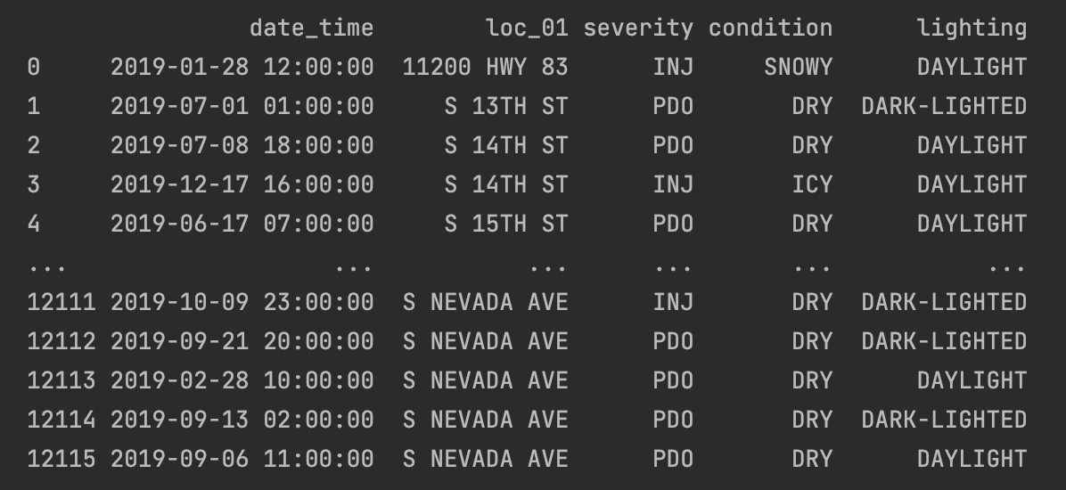
Data Cleaning: CDOT
Filter all the crashes that happened within El Paso county.
Match location names with Waze and Weather data to enhance data merging accuracy:
Change the placement of the direction indicator in the street names
Convert synonymic highways or roads names into identical formats
Round time of the crashes to hourly increments
Notes:
Chengyuan

Slide 18

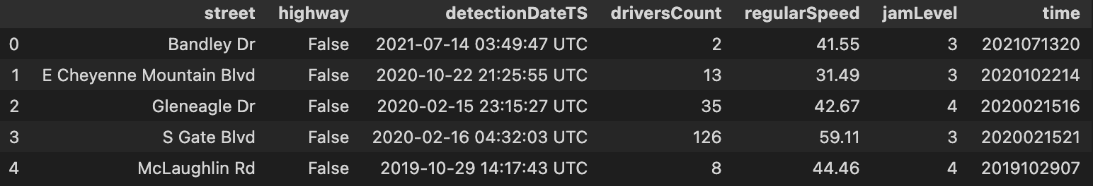
Data Cleaning: Waze
Determine relevant columns
Convert Detection Date from UTC-format to simple MST
2021-07-14 03:49:47 UTC -> 2021071320
Currently using 2019 data

Slide 19

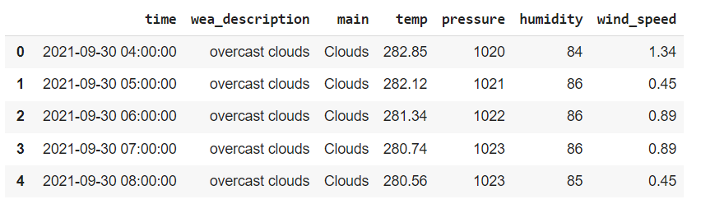
Data Cleaning: Open Weather
Determine relevant columns such as:
Temperature, pressure, humidity
Wind speed, wind degree
Weather description
Concatenate date and time to make it standardized
Feature engineering, one hot encoding for weather description
Notes:
+sample

Slide 20
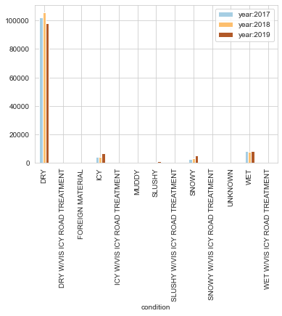
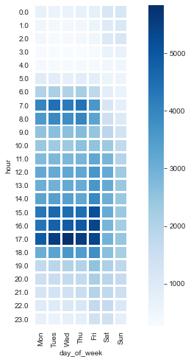
Exploratory Data Analysis: crash, weather and time
Group by weather (17-19)
Group by time and day of week
Key takeaways
In extreme weather, crashes can be concentrated. Snow and ice bringing slightly more crashes in 2019.
Meanwhile, crushes occur frequently during the morning and evening rush hours on weekdays
Notes:
takeaways

Slide 21
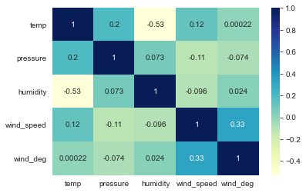
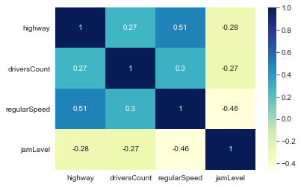
Exploratory Data Analysis: Features Correlation
Corr matrix for weather data
Corr matrix for cdot data
Key takeaways: Detect correlation between variables (highway & driving speed; wind speed & temperature, etc.). It is recommended to select only one of the relevant variables or to use a model that is not sensitive to correlation.

Slide 22




Dataset Preparation for Modelling
Join on Street and Hourly Timestamp
Join on Hourly Timestamp
Final Dataset

Slide 23
Features considered for the Model
Weather Score
Clouds
Snow
Driver Count
Wind Speed & Degree
Relevant Features
Average Speed
Humidity
Jam Level
Temperature

Slide 24
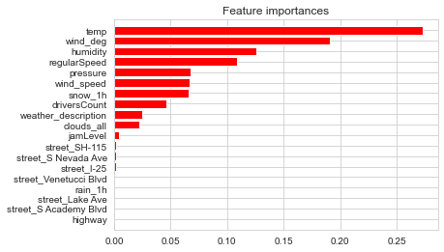
Feature Importance
Features | Importance
Temperature | 0.268
Wind Degree | 0.158
Humidity | 0.146
Average Vehicle Speed | 0.109
Air Pressure | 0.075
Wind Speed | 0.082
Snow | 0.089
Driver Count | 0.026
Weather Score | 0.017
Jam Level | 0.006
Clouds | 0.017

Slide 25
Model Selection and Output
Decision Tree algorithm for better readability
Choosing f1_score as the metric
Test metrics: 0.98
Class imbalance
Size of the dataset

Slide 26
Next Steps
Re-evaluate model to investigate the suspiciously high f1-score
Investigate the presence of class imbalance.
Integrate additional years and streets into the data + model.
Split data on hourly basis instead of day-to-day basis for increasing data points.
Create safety metric ranges based on crash percentage.
Notes:
Ananya

Slide 27
Questions to Consider
Are there any issues we may have overlooked with our current plan?
Are there other approaches we should consider to address the problem?
Are there any other key stakeholders that we should consider?
Notes:
Ananya

Slide 28
Future Risks
Biggest Issue at hand - How to integrate other years apart from 2019 in the Waze dataset?
Solution -
In case, the F1 Score does not improve after fixing previous issues addressed or in case we don’t manage to identify data for years apart from 2019, we need to use the model involving crash percentage, since this model only utilizes CDOT and Weather datasets that contain data for other years as well.
Notes:
Ananya

Slide 29
Questions

